Slide 1
FIFO BUFFER
A FIFO (first-in-first-out) buffer is an "elastic" storage between two subsystems, as shown in the conceptual diagram. It has two control signals, wr and rd, for write and read operations. When wr is asserted, the input data is written into the buffer. The read operation (rd ==1) remove the data from the buffer. Design a FIFO in Verilog.

Slide 2
FIFO realized using a circular buffer

Slide 3
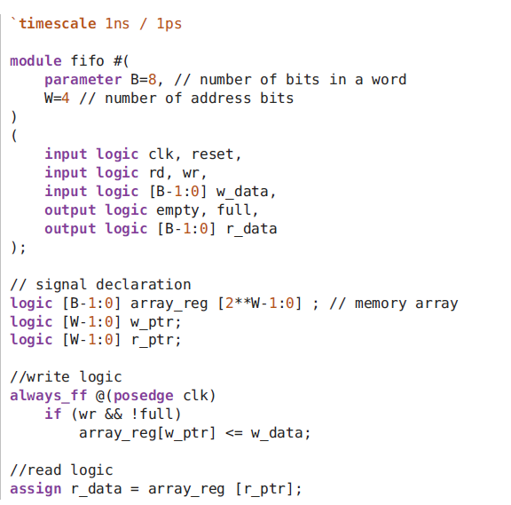
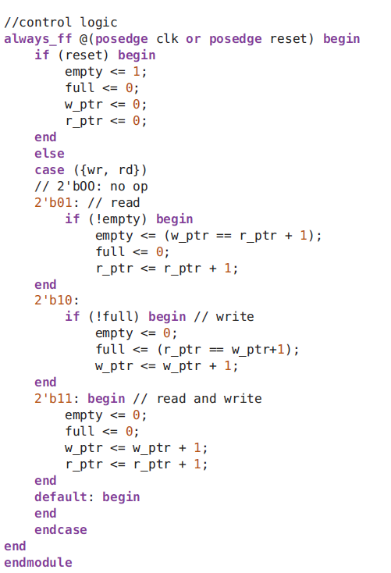
FIFO realized using a circular buffer

Slide 4
FIFO testbench

